Slide 1
CER4C3 Abstraction and Paradigms of Programming
Bachelor of Engineering
Computer Engineering II Year IV Sem

Slide 2
Introduction to Parallel Programming (Computing)
let’s take a look at the background of computations of computer software and why it failed for the modern era.
Computer software was written conventionally for serial computing.
This meant that to solve a problem, an algorithm divides the problem into smaller instructions.
These discrete instructions are then executed on the Central Processing Unit of a computer one by one.
Only after one instruction is finished, next one starts.

Slide 3
Serial/Sequential Programming
Serial Computing is following:
In this, a problem statement is broken into discrete instructions.
Then the instructions are executed one by one.
Only one instruction is executed at any moment of time.

Slide 4
Only one instruction is executed at any moment of time
This was causing a huge problem in the computing industry as only one instruction was getting executed at any moment of time.
This was a huge waste of hardware resources as only one part of the hardware will be running for particular instruction and of time.
As problem statements were getting heavier and bulkier, so does the amount of time in execution of those statements.
Examples of processors are Pentium 3 and Pentium 4.

Slide 5
Parallel Programming
It is the use of multiple processing elements simultaneously for solving any problem.
Problems are broken down into instructions and are solved concurrently as each resource that has been applied to work is working at the same time.
Also known as parallel processing or parallel computing
Example can be Instruction Pipelining

Slide 6
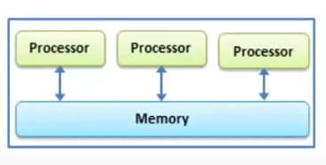
Parallel Programming
The problem to be solved is divided into discrete parts.
Each part is further broken down into instructions.
These instructions are divided between processors.
As a result multiple processors are executing the instructions simultaneously.
Parallel programming can be useful when there is a complex and large task that too with strict time limits, rather than relying on a single processor, the work can be divided between multiple processors (different machines)

Slide 7
Disadvantages of Parallel Programming
There is a possibility of a race around condition or deadlock, i.e. the entity on which one of the processor is operating may be required by another processor. In computer architecture this is known as data hazard.
E.g. I1 : Add R1 R2
I2 : Add R2 R3
I3 : Add R1 R4

Slide 8
Let’s Revisit the Instruction Cycles
I1 : Add R1 R2
I2 : Add R2 R3
I3 : Add R1 R4
Fetch | Decode | Excecute | Memory Access | Write Back
I1
I2 | I1
I3 | I2 | I1
 | I3 | I2 | I1
 | I3 |  | I2 | I1
 | I3 |  |  | I2
 |  | I3
 |  |  | I3
 |  |  |  | I3
2 cycles wasted because of data hazard

Slide 9
Disadvantages of Parallel Programming
Meaning that, parallel programming can only be useful when the sequence of blocks that are to be executed are independent of each other. (There are no dependencies WAW, WAR, RAW)
Moreover, adding more processors can prove to be a bit costly.

Slide 10
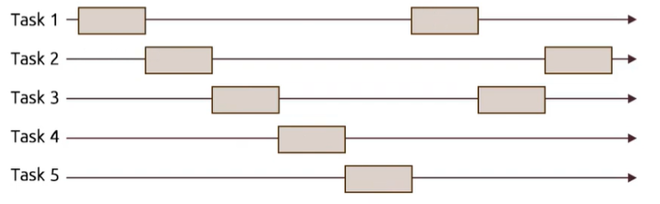
Concurrent Programming
The word concurrent describes the things that are occurring at the same time, or the people doing certain things at the same time.
E.g. Concurrent users of a computer program.
In a concurrent program, several streams of operations may execute concurrently. Each stream of operation executes as it would in a sequential program except to the fact that streams can communicate and share data with one another.

Slide 11
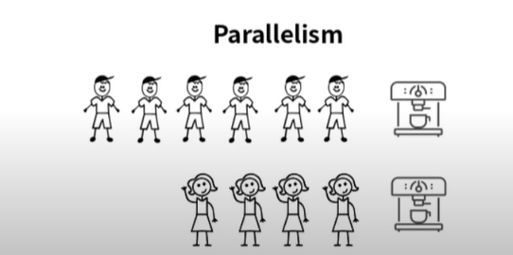
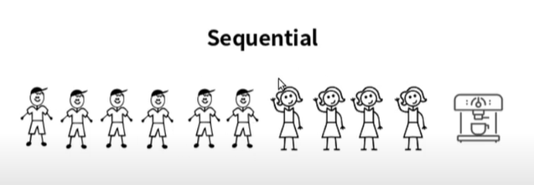
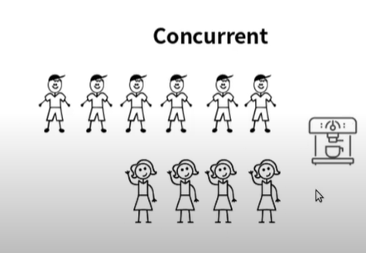
Concurrent Programming
Concurrency is a property of the system which enables overlapping of process lifetimes

Slide 12
Concurrency V/S Parallelism
Concurrency – Act of managing and running multiple computations at the same time.
Parallelism – Act of running multiple computations simultaneously.

Slide 13
Logic Programming – Introduction to ProLog
Logic programming is the use of a formal logic notation to communicate computational processes to a computer.
Predicate calculus is the notation used in current logic programming languages.
Programming in logic programming languages is nonprocedural. Programs in such languages do not state exactly how a result is to be computed but rather describe the necessary form and/or characteristics of the result.
What is needed to provide this capability in logic programming languages is a concise means of supplying the computer with both the relevant information and an inferencing process for computing desired results.

Slide 14
Logic Programming
Predicate calculus supplies the basic form of communication to the computer.
Prolog programs consist of collections of statements.
The database of a Prolog program consists of two kinds of statements: facts and rules.
The following are examples of fact statements:
mother(joanne, jake)
father(vern, joanne)
These state that joanne is the mother of jake, and vern is the father of joanne.

Slide 15
Logic Programming
An example of a rule statement is
grandparent(X, Z) :- parent(X, Y), parent(Y, Z)
This states that it can be deduced that X is the grandparent of Z,
if it is true that X is the parent of Y and Y is the parent of Z, for some specific values for the variables X, Y, and Z.

